Slide 1


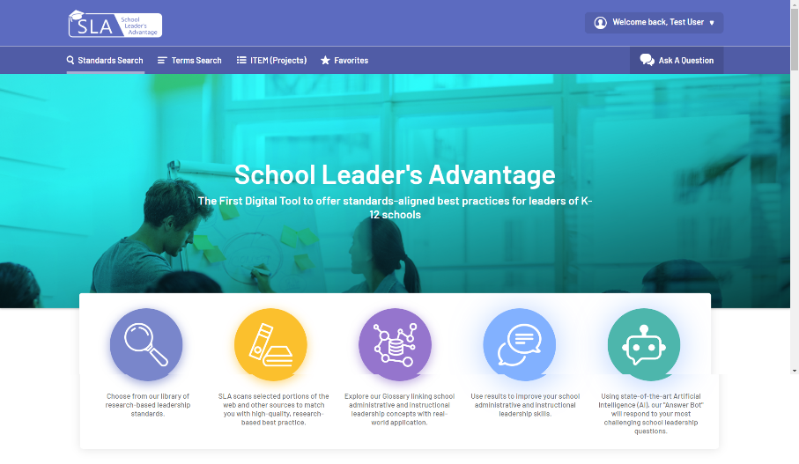
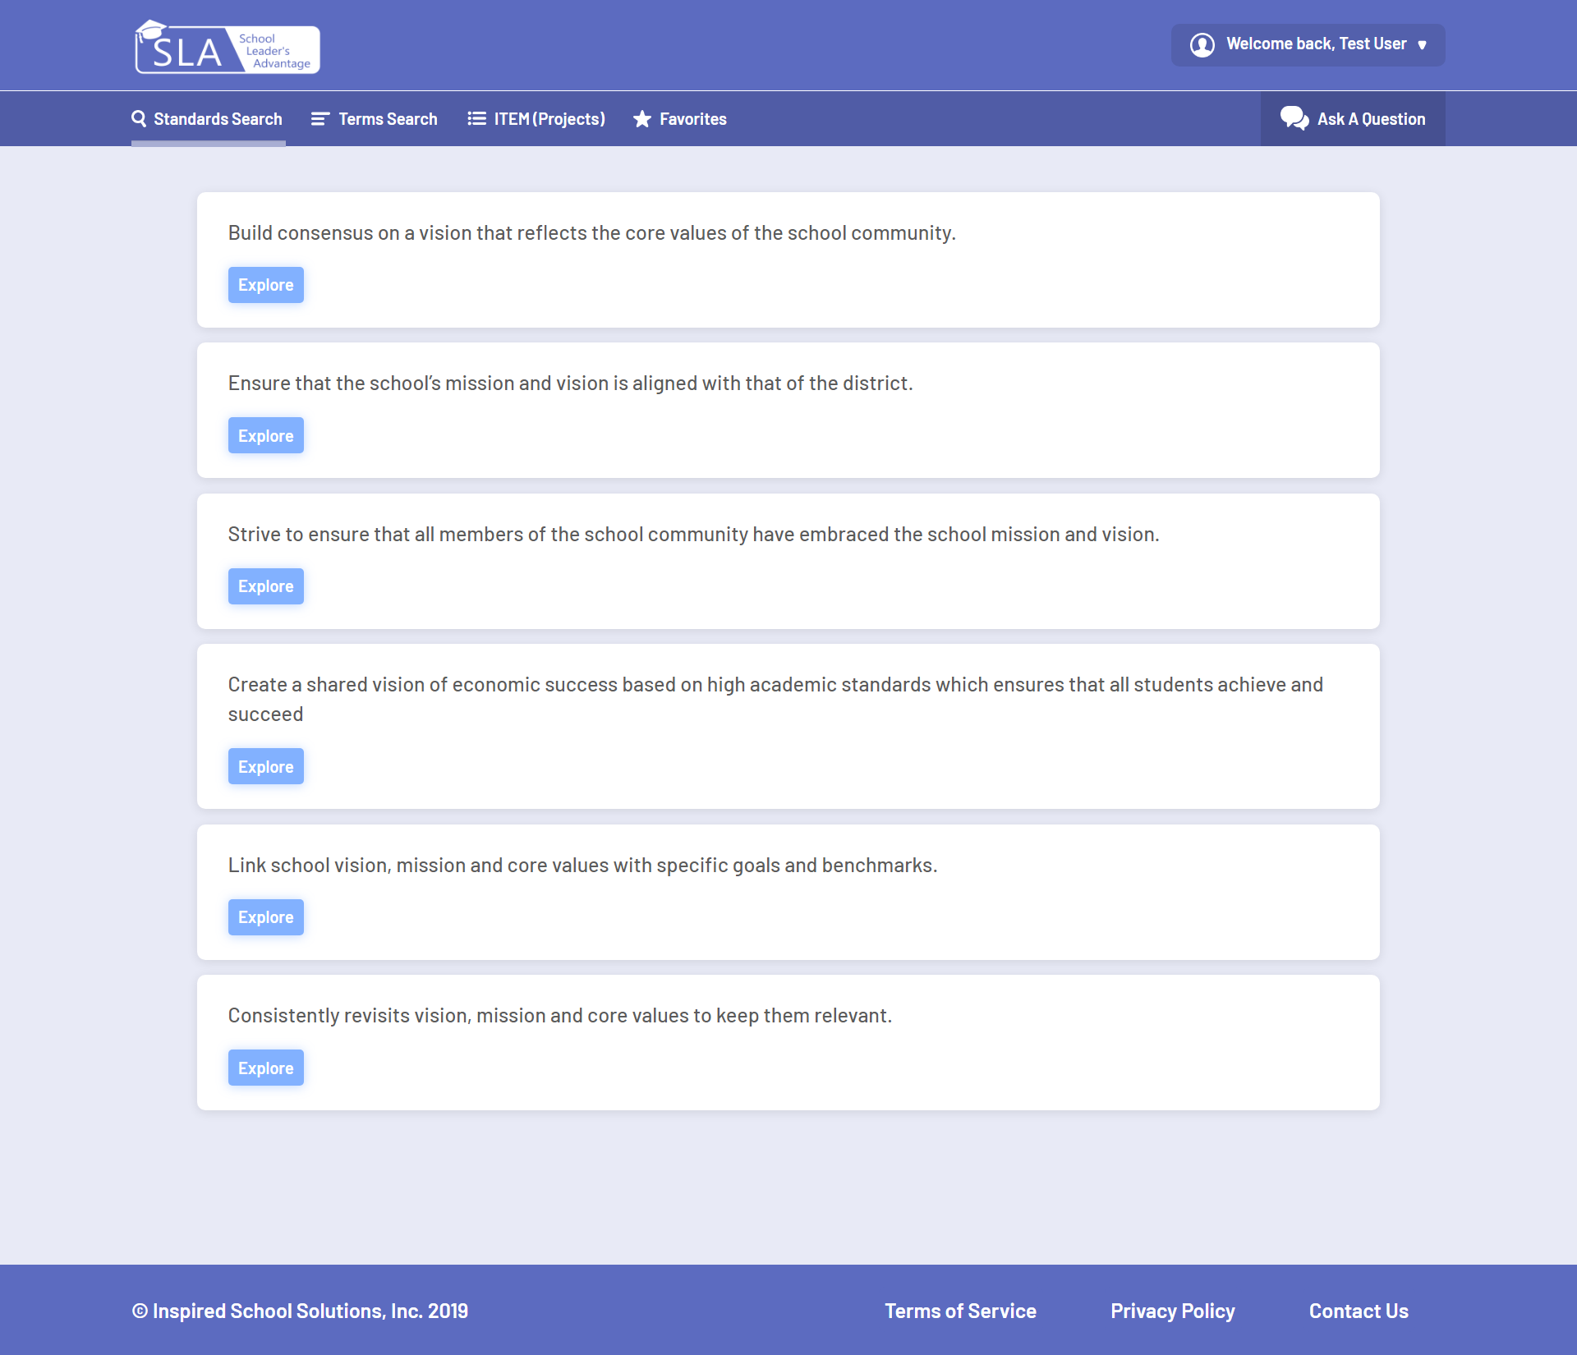




Inspired School Solutions
Ben Mirtchouk, Varun Pilly, Akhilesh Reddy, Avaneesh Kolluri
Problem
Mission Statement
Features
Principal’s Issue
Why not Google?
Our goal is to provide a platform for instructors and principals to have access to an extensive database of tailored resources in order to improve the level of education offered.
Standards Search Engine that returns a relevant set of standards tailored to the user’s search
User can bookmark his/her favorite standards and see them dynamically updated in the favorites page
AI Driven Chat-Bot that allows for quick access and recommendations of standards and practices for principals
ITEM Project Manager that allows principals to implement, track and asses the best practices
Administration Panel and User Management
Quick and Easy Payment Integration
Principal’s have many issues to manage in schools that require immediate attention.
Because of a lack of resources to help manage the school, principals have been leaving their jobs.
Google or Bing are swamped with too many results that principals have to browse to solve their problems.
Scalability
Standards Search
Technologies Used
Statistic
Market Size
> 1%
Less than 1% of America’s education budget is use for school administrators
Principals are an underserved audience
$1.3 Trillion
K-12 American Education is assessed at $1.3 trillion
Fast growing sector
100 Million
School leaders estimate 475k more US users (Principals and VP’s)
Potential for 100 Million global users
Contact Information:
Ben Mirtchouk bmirtch1@stevens.edu | Varun Pilly vpilly@stevens.edu | Akhilesh Reddy areddy5@stevens.edu | Avaneesh Kolluri akolluri@stevens.edu

